Slide 1



Design and Development of ShopSphere : An Online Shopping System
Course Code: CSTE 3206
Presented to
Ratnadip Kuri
Assistant Professor
Department of Computer Science & Telecommunication Engineering, NSTU.
Presented by
Mohammad Borhan Uddin (ID : ASH2101008M)
Mohammad Billal Hossain (ID : MUH2101028M)

Slide 2


Introduction
ShopSphere is a web-based e-commerce platform that allows users to browse products, manage carts, and place orders easily.
It also provides administrators with full control over product listings and order management, ensuring a smooth and efficient shopping experience.
Goal: Build a secure, user-friendly, and admin-controllable e-commerce web application with optional payment features.

Slide 3


Objectives
Develop a responsive e-commerce web application
Enable seamless product browsing, cart management, and order placement
Admin panel for managing products and orders
Optional secure payment with Stripe
Ensure scalability and maintainability

Slide 4

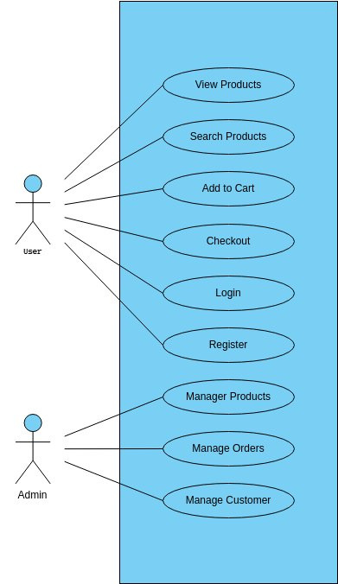
Features
User Features:
Authentication
Product browsing and filtering
Cart and Checkout options
Admin Features:
Product Management
Order Management
User account control
User Interaction Diagram

Slide 5
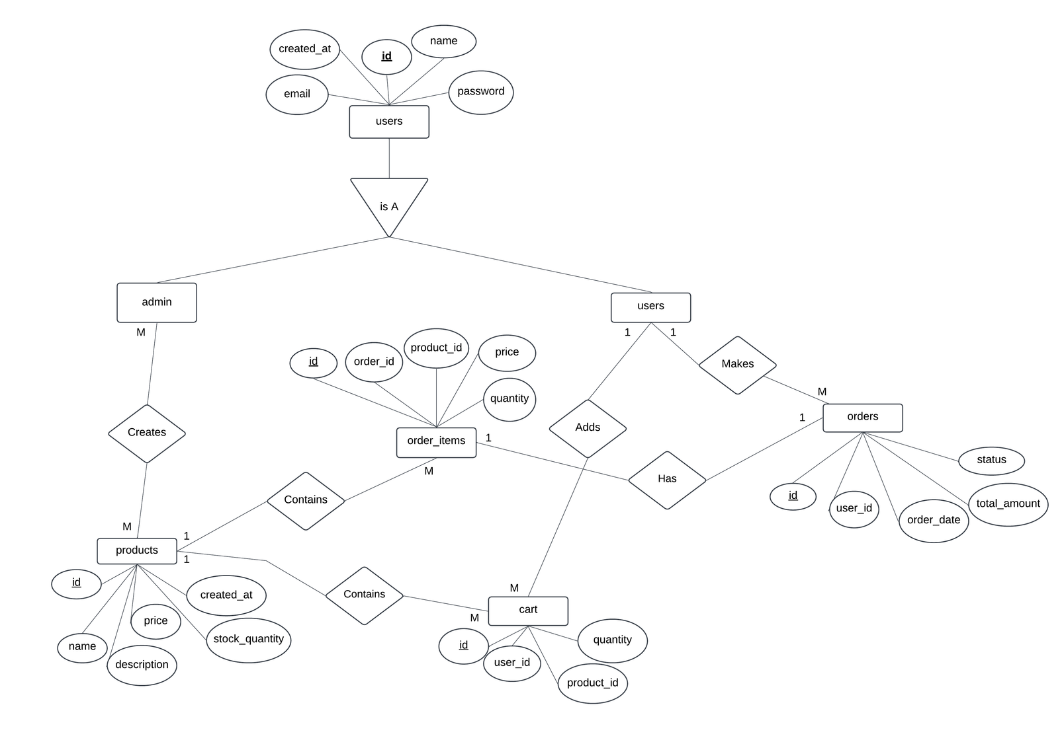

Entity-Relationship Diagram

Slide 6
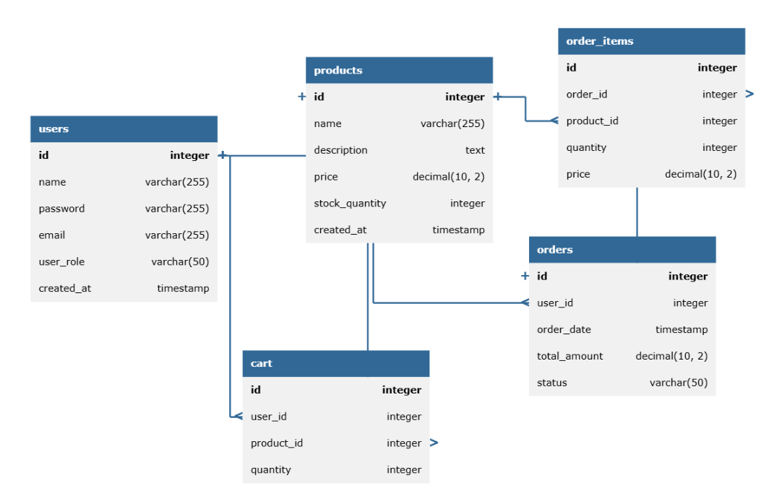
De
Database Design

Slide 7
Technology Stack
1
Frontend :
React JS, TailwindCSS/ Bootstrap,
2
Backend:
PHP/Laravel or ExpressJS
3
Database:
MySql

Slide 8
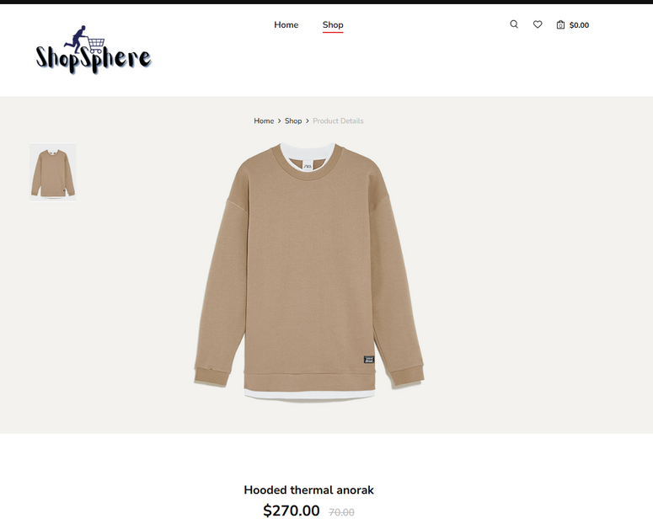
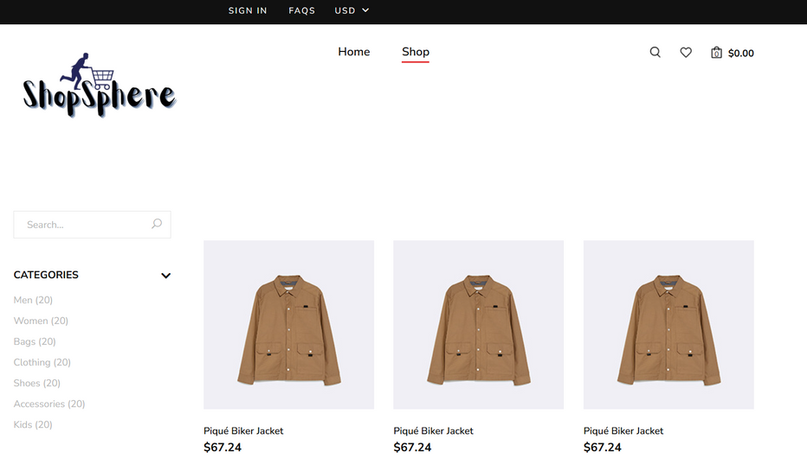
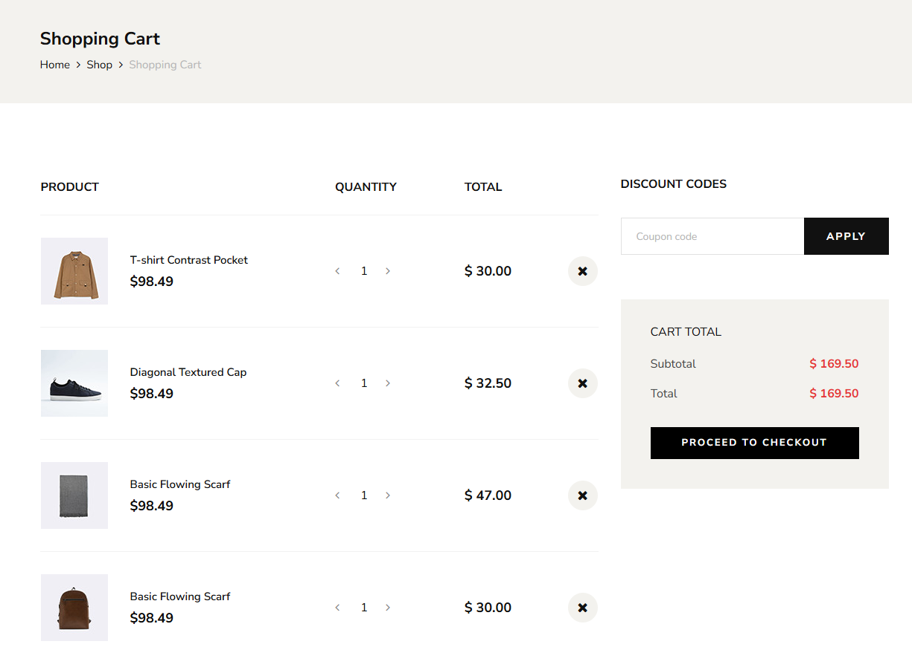
Screenshots

Slide 9
Any Queries ?

Slide 10
Thank
You

